Slide 1
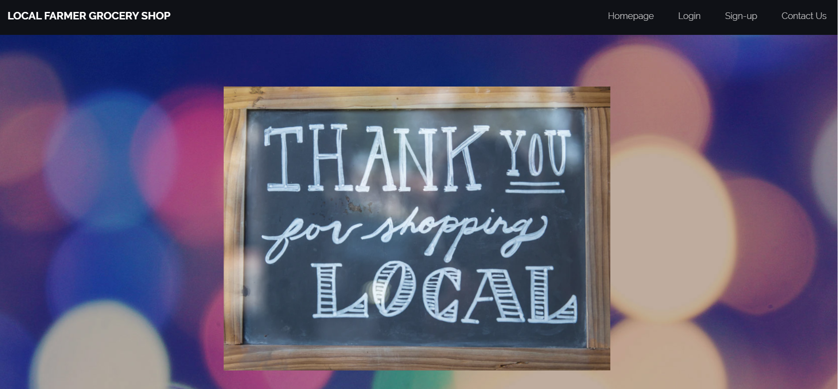
Notes:
../index.html

Slide 2
Process

Slide 3
Technologies - Stack
BootStrap
PUG (Replaced by Express-handlebars)
Express
Sequelize
MySQL

Slide 4
Breakdown of tasks and roles
Mike : Worked on the middleware Authentication Passport, routes and frontend Pages
Ian: Worked on the Sequelize modals and frontend
Abel : Worked on Routes and handlebars and the frontend as well

Slide 5
Technologies – NPM Packages
Bcryptjs
Express-session
Mysql2
Parser
Passport
Passport-local
Sequelize

Slide 6
DEMO

Slide 7
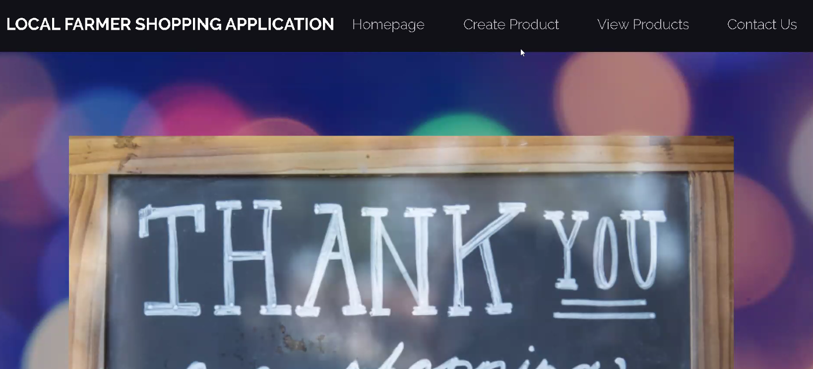

Slide 8
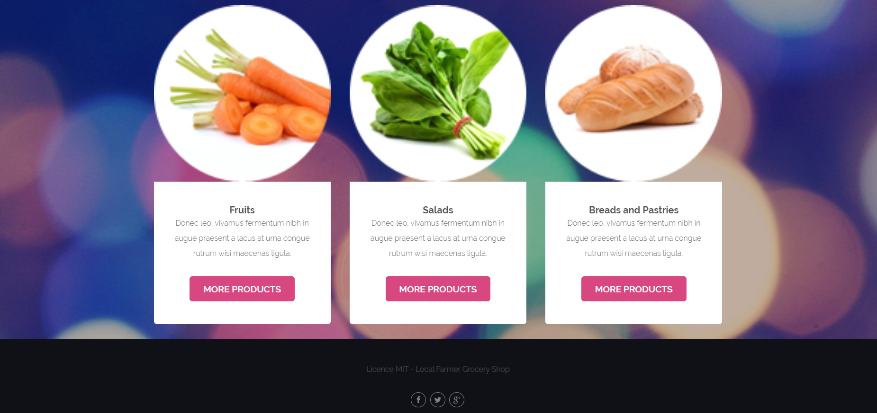

Slide 9
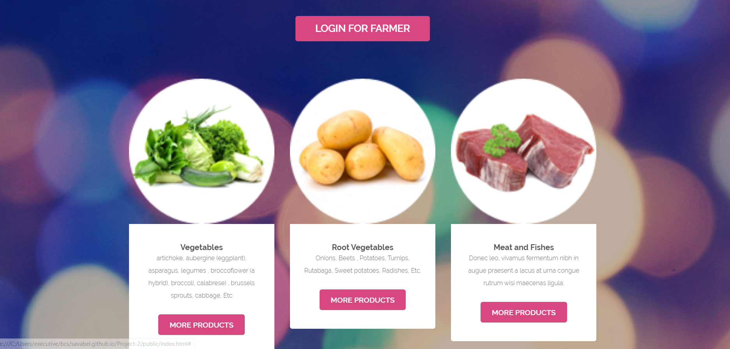

Slide 10
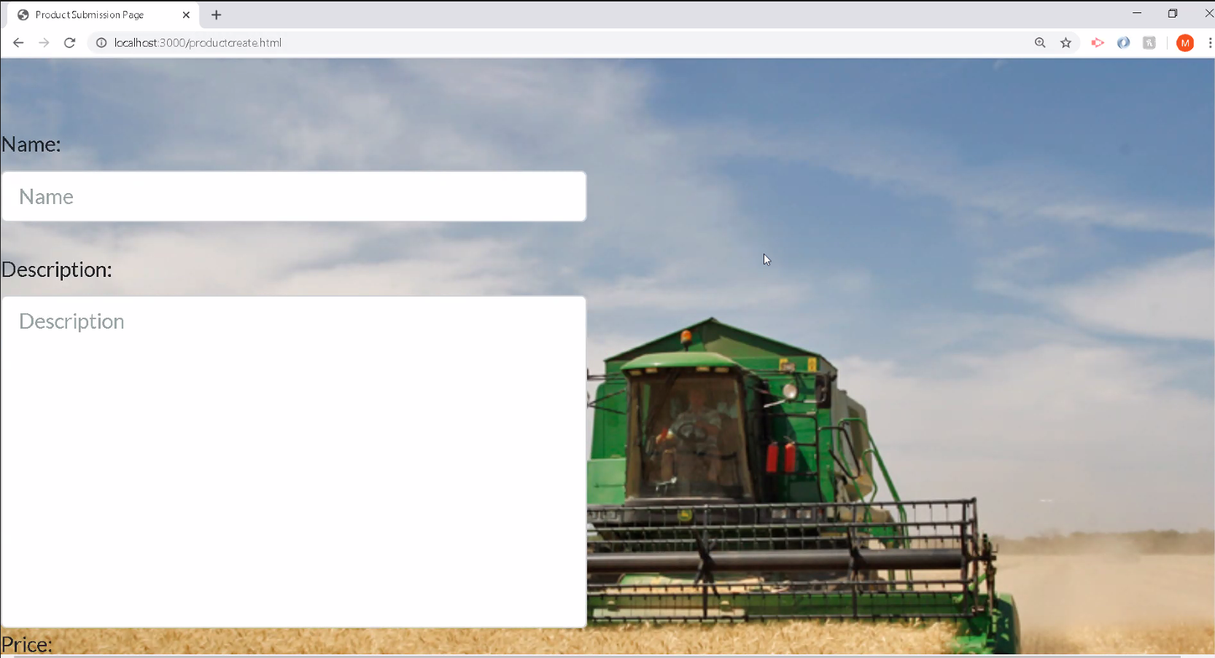

Slide 11
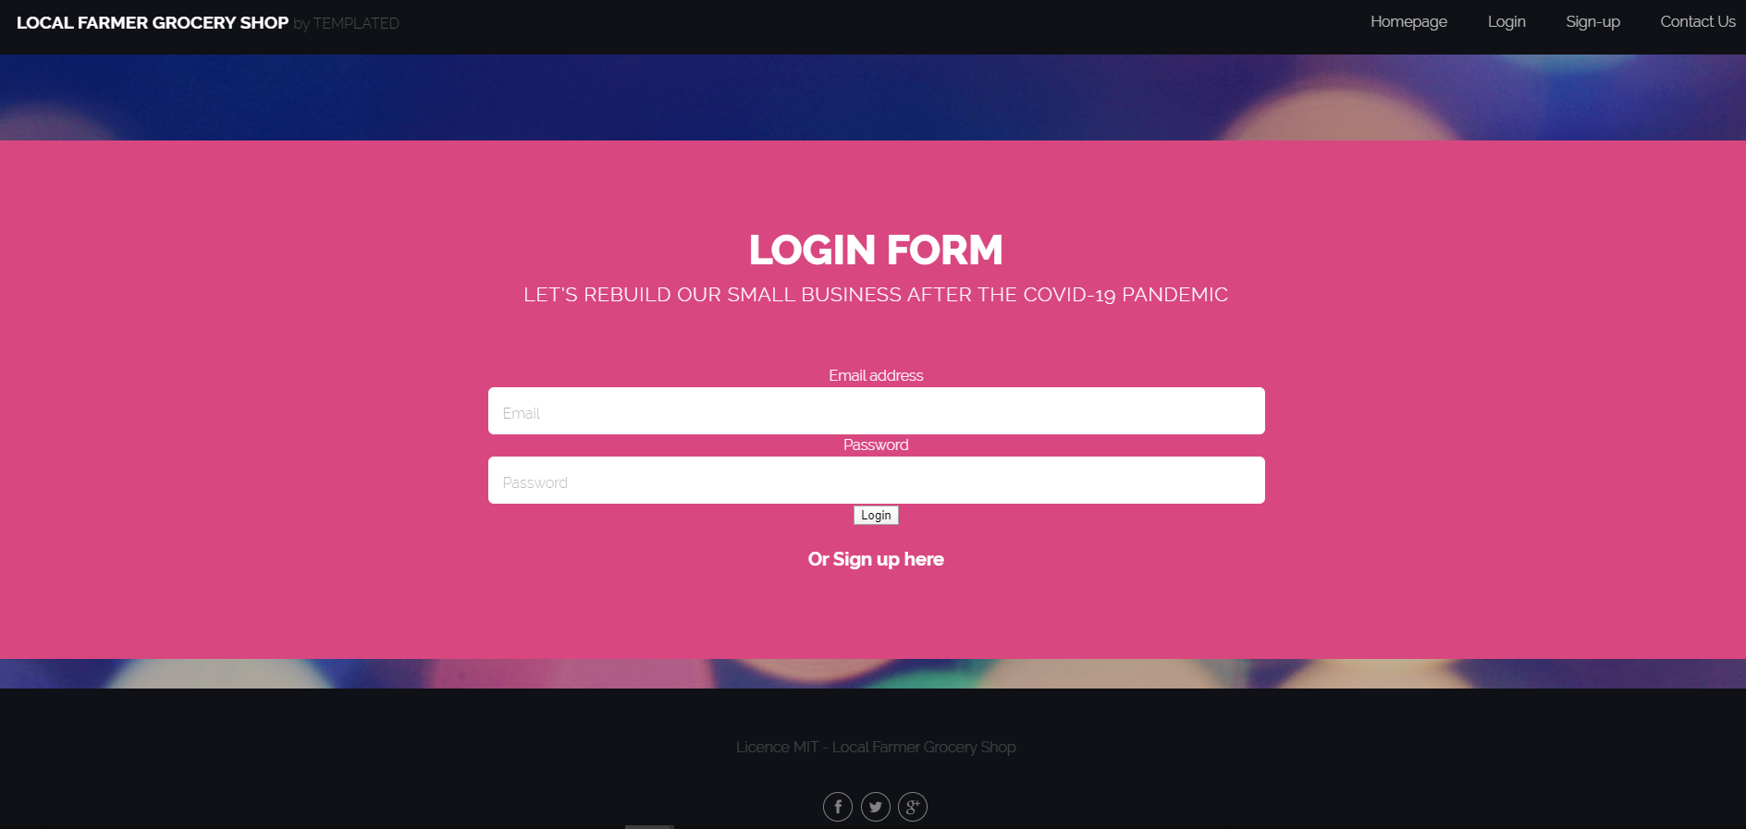

Slide 12
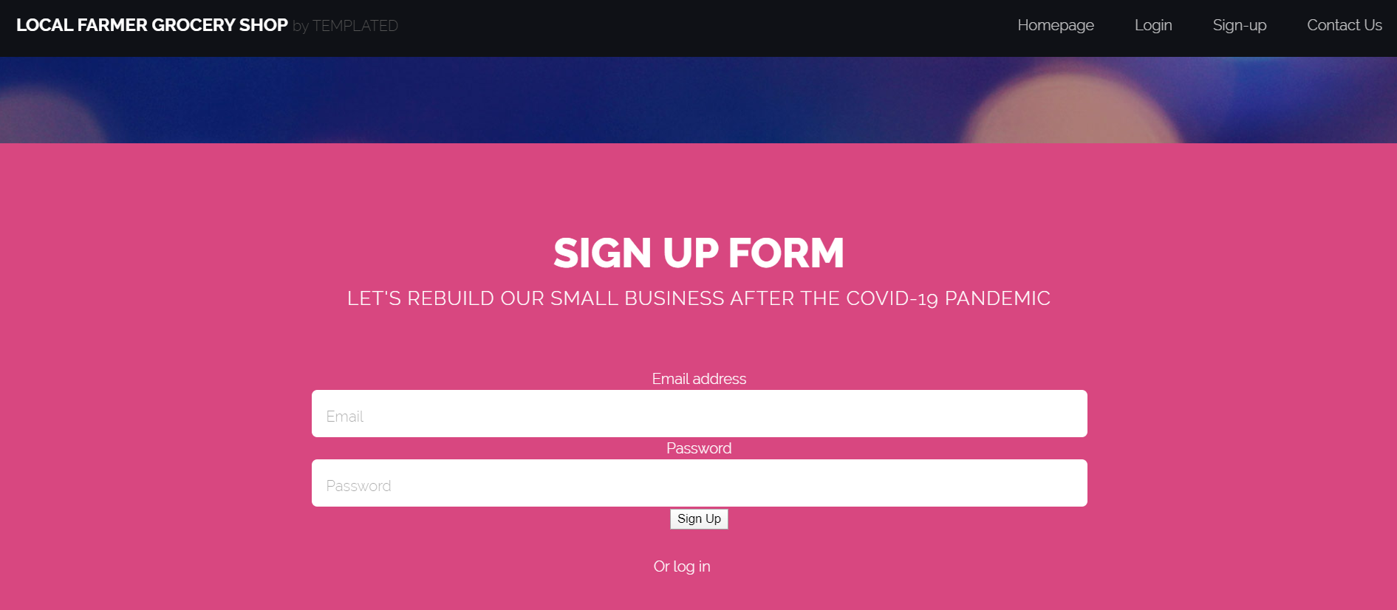

Slide 13
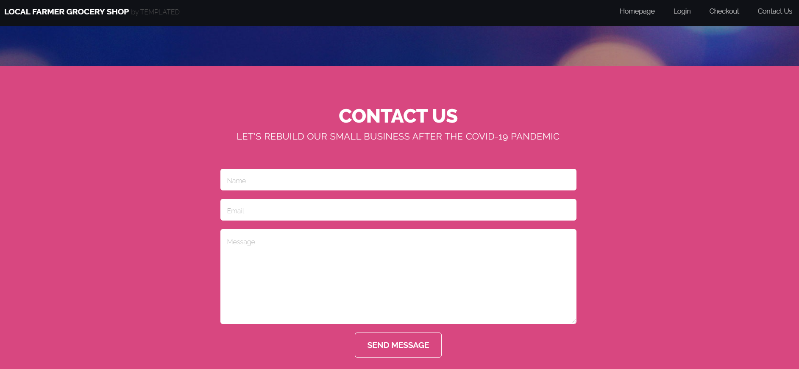

Slide 14
Direction for future Development
Add likes on Products
Add Comments on products
Add Search functionality
Develop a more robust recommendation engine
- Nearby Farmer
- Product Prices Comparison
- Delivery and Online ordering.

Slide 15
Special Thanks
Remember support our economy by buying at Local Farmer Grocery Shop.
- Robert
- Abdul
- Igor

